Slide 1
My voice, my rights, my choice
The significance of independent advocacy in eating disorder services for patient treatment and recovery
By Sukayna Al-Aaraji
Independent Mental Health Advocate (IMHA)
Specialist advocate for eating disorder services

Slide 2
Overview of Advocacy
“Taking action to help people say what they want,
secure their rights, represent their interests and obtain
their services they need”
Advocacy Charter 2002

Slide 3
The role of the advocate

Slide 4
Overview of IMHA (Independent Mental Health Advocacy)
Qualifying patients include those:
Detained under the Mental Health Act (1983)
Conditionally discharged restricted patients
Patients under supervised community treatment order (CTO)
Patients being considered for treatment under Section 57 and Section 58A
Patients subject to guardianship
It is the detaining authority’s responsibility to inform qualifying patients of their right to access an IMHA.
IMHA will also work with:
Informal/Non-qualifying patients on the ward and in the community.
IMHAs are not IMCAs (Independent Mental Capacity Advocates).

Slide 5
What the advocate will do
Offers support that is independent, confidential and without a ‘best interest’ approach
Advocates will:
Explain what we do to the people we work with
Provide information leaflets about what we do
Always explain the options and consequences
Work to an action plan
Advocates will not:
Judge or advise
Collude with unfounded allegations and complaints
Interfere with treatment

Slide 6
Summary of the role
It is:
Independent
Confidential
User led
How:
Take instructions only from the person we work with
Provide information and options, not advice
Discuss implications and consequences

Slide 7
Advocacy and eating disorders

Slide 8
Advocacy for eating disorder services
1. Bridging the relationship between the patient and their treatment team
Recovery
Patient
Treatment team
Advocate

Slide 9
Advocacy for eating disorder services
2. Addressing the power imbalances
Treatment team
Advocate
Patient

Slide 10
Advocacy for eating disorder services
3. Informing patients
I want to ask for a decrease in diet
I am telling someone how I feel
My treatment team may agree I am ready to have a change in diet/care plan
My treatment team may be able to help me deal with the difficulty I am having with food in other ways
My leave may be suspended
My team may decided to put me on 1:1 observation
I may be sectioned
I may have to stay in hospital for longer
Patient + Advocate

Slide 11
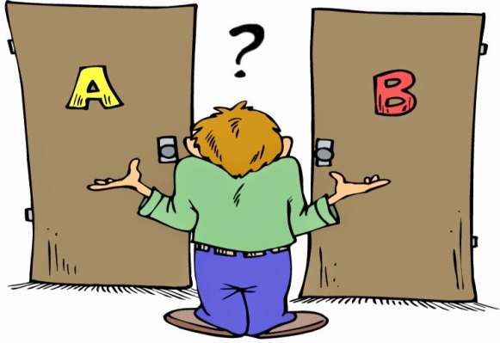
Advocacy for eating disorder services
4. Remember: we are not decision makers
Advocate
Treatment team
Treatment team
Patient

Slide 12
Myths about advocacy

Slide 13
Myths about advocacy
Myths | Facts
We don’t know anything about mental health We criticise your practice We interfere with treatment We give advice and opinions We always make complaints and raise unnecessary safeguard alerts | Advocates come from various educational backgrounds, including nursing, psychology, law and social work. We also have to complete a UK National Advocacy Qualification (NAQ). We are not in a clinical role, and hence never comment on clinical decisions. However, we encourage patients to ask questions regarding these decisions if they’re unsure. We never interfere with treatment and inform patients that treatment takes priority over advocacy, eg, we never hold advocacy sessions during meal/supervision times. We never advise; we inform. We also do not give opinions even if asked, as stipulated in Advocacy Charter (2002); we instead signpost them to their clinical team for medical advice and opinions. Complaints and safeguard alerts are always a last resort if a patient feels unsafe or have not been listened to, if we observe something that we feel needs a second opinion. We also aim to seek patient’s consent under section 42 of the Care Act before raising an alert.

Slide 14
Myths about advocacy
Myths | Facts
We are obliged to discuss complaints and safeguard issues with clinical teams before raising them. | It is part of our role to raise safeguard alerts on a regular basis. This is simply procedure and not for persecutory purposes. The most important part of our role as advocates is to maintain our independence and confidentiality. We therefore do not discuss complaints and safeguards with you unless requested by the patient. We will, however, inform you where possible when a safeguard alert has been raised.

Slide 15
Patient survey

Slide 16
Survey method
Fitness for purpose
To understand the impact of advocacy on patients in specialist units receiving treatment for eating disorders.
Methodology
The following survey was conducted at Vincent Square Eating Disorder Service, Great Ormond Street Hospital (Mildred Creek Unit), Collingham Child and Family Service, and Ealing Forensic Services. 10 patients using our service (formal and informal) were randomly selected and asked to fill out an anonymous questionnaire across these services.
Ethics
Each patient was given an identical sheet with four questions to answer, and were asked to hand them back to the advocate in an unmarked envelope provided. Only once all envelopes were collected across all services, they were opened and the results were analysed. All patients consented to completing the survey and were explained how answers would be used.

Slide 17
Survey questions
What was your understanding of patient advocacy before you began working with an advocate?
How did advocacy help throughout your admission? Was there anything that wasn’t helpful about advocacy?
What are your thoughts on the importance of ‘independent’ advocacy, and do you think the ‘independence’ had any contribution to the effectiveness of engaging with your treatment team?
Do you think your admission would have been different if advocacy wasn’t available?

Slide 18
Presentation of findings
What was your understanding of patient advocacy before you began working with an advocate?
Overall patient understanding of advocacy at the beginning of their admission was generally broad.
How did advocacy help throughout your admission? Was there anything that wasn’t helpful about advocacy?
Most patients said advocacy was helpful during admission. These reasons varied. One patient said they did not find advocacy helpful.
What are your thoughts on the importance of ‘independent’ advocacy, and do you think the ‘independence’ had any contribution to the effectiveness of engaging with your treatment team?
Patients said independence of the service ensured information provided by the advocate was objective and not based on medical opinions.
Do you think your admission would have been different if advocacy wasn’t available?
Every patient interviewed said not having access to advocacy would have negatively impacted their admission.

Slide 19
Conclusion
Our survey revealed patients treated for eating disorders benefited from advocacy in the following ways:
It helped them to better understand their rights as formal or informal patients.
They felt able to discuss issues around treatment with an advocate first before raising it with their clinical team.
They valued the independence of the service, as it ensured objectivity.
It helped them build a more trusting relationship with their clinical team.
The quality of their admission was improved, therefore, they were more likely to engage in treatment.

Slide 20
The Advocacy Charter
Independence
Person centered approach
Empowerment
Equal opportunity
Accessibility
Supporting advocates
Accountability
Confidentiality
Complaint
Safeguarding
“Advocacy is taking action to help people say what they want, secure their rights, represent their interests and obtain services they need. Advocates and advocacy schemes work in partnership with the people they support and take their side.”

Slide 21
Contacts
The Advocacy Project
73 St. Charles Square
London, W6 6EJ
Telephone: 0208 969 3000
Email: sukayna@advocacyproject.org.uk
www.advocacyproject.org.uk

Slide 22
Thank you.
Any questions?

